Slide 1


The Introduction of
GRIN CLASSIFIER BY
VI Elements Consortium
An Application that helps you understand human awareness and bias towards climate change

Slide 2
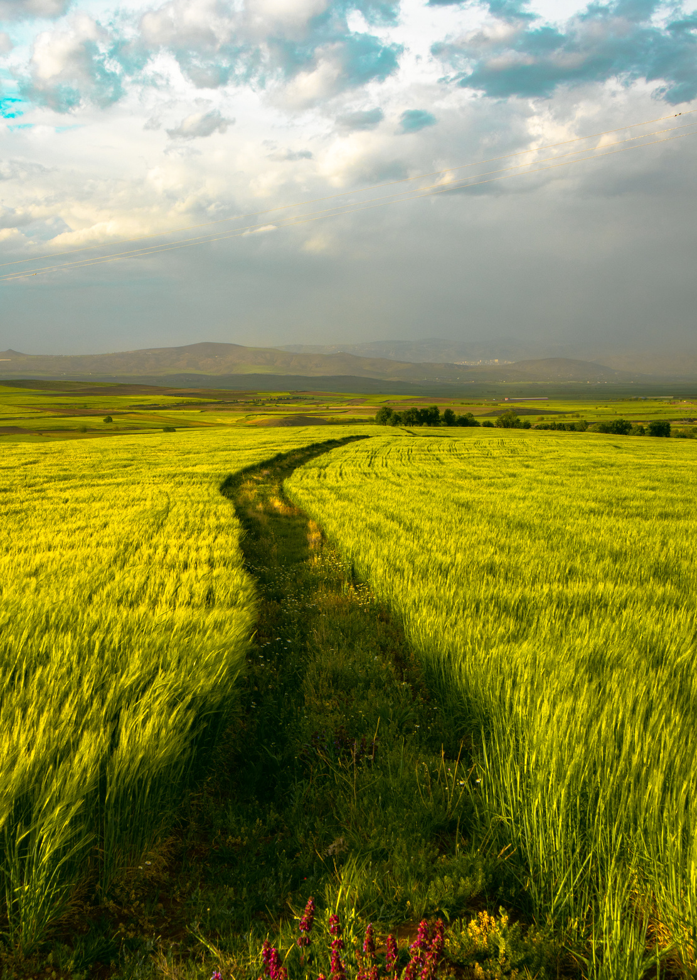




Outline
About Us
Vision | Mission | Values | People
Problem Statement
Overview | Background | Statement
Grin Classifier
Framework | EDA | Data Engineering | Model
Organizational Benefits
Impact on Sales Campaign | Cost effectiveness
Conclusion

Slide 3




About Us
Mission
To promote a data-centric approach to problem solving in Africa through the provision of innovative data-driven solutions and training
Vision
To become a leading data-driven solutions provider
Values
Excellence, Integrity, Collaboration, Respect and Client-centered services

Slide 4
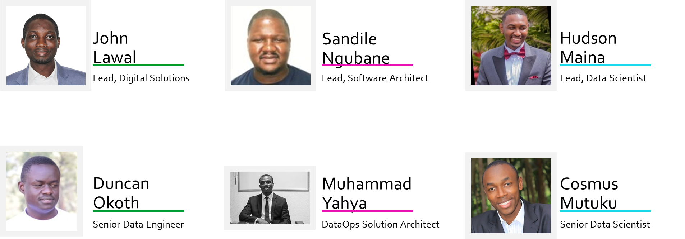
The Team

Slide 5


Overview
Since the UN adopted the Sustainable Development Goals in 2015, the call to protect our planet has become a collective action.

Slide 6

Problem Statement
According to the report from your 2021 AGM;
GWS Global's inability to breakeven despite the huge investment in environment friendly products and services.
Failed sales campaign due to the level of awareness and climate change sentiments of targeted audience.
Notes:
According to the report from your 2021 Annual General Meeting, it was discovered that considering your vast investment in the production of environmental friendly products and services, still you are not able to breakeven notwithstanding the numerous awards received as a leading manufacturer of best in class "Green" products and services. as the level of acceptance of their products is considerably low due to the level of awareness and individual sentiments.

Slide 7




Grin Classifier
Data Collection
EDA
Data Engineering

Slide 8
Grin Classifier
Data Collection
Social media scraping technique was used in gathering data for this project

Slide 9
Grin Classifier
Exploratory Data Analysis
This solution is built on an error free framework with a detailed EDA as its bedrock.
Both graphical and statistical EDA methods were employed.

Slide 10
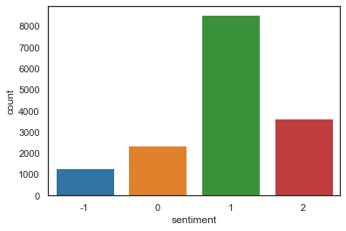
Sentiments Classes Distribution
Notes:
From the figure above we observe that there is an imbalanced distribution of sentiments classes in the training data.
This class imbalance could result in the model classifying most of the tweets into sentiment class 1 since the model gets better at classifying class 1 tweets as the model has more evidence of class 1 tweets. The preprocessing and modeling section of the predict will take this into account.

Slide 11
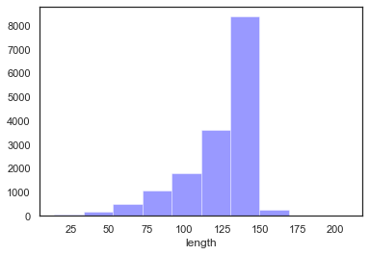
Distribution of tweets length in the train data

Slide 12
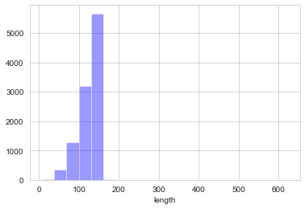
Distribution of tweets length in the test data
Notes:
distribution of tweets length in the test data

Slide 13
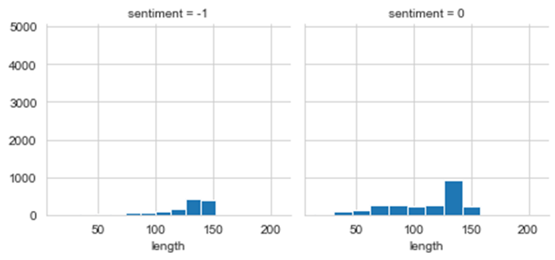
Length of tweets per sentiment
Notes:
In figure 1, we observe that there is an imbalanced distribution of sentiments classes in the training data.
In figure 2, distribution of tweets length in the train data
In figure 3, distribution of tweets length in the train data
We undertake an analysis of the buzzwords in the tweets data by extracting the most frequently used words and hashtags.

Slide 14
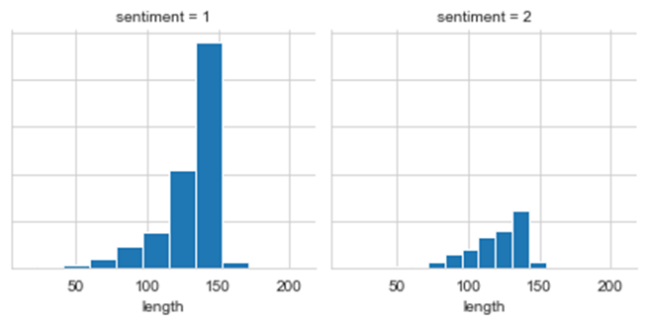
Length of tweets per sentiment
Notes:
In figure 1, we observe that there is an imbalanced distribution of sentiments classes in the training data.
In figure 2, distribution of tweets length in the train data
In figure 3, distribution of tweets length in the train data
We undertake an analysis of the buzzwords in the tweets data by extracting the most frequently used words and hashtags.

Slide 15
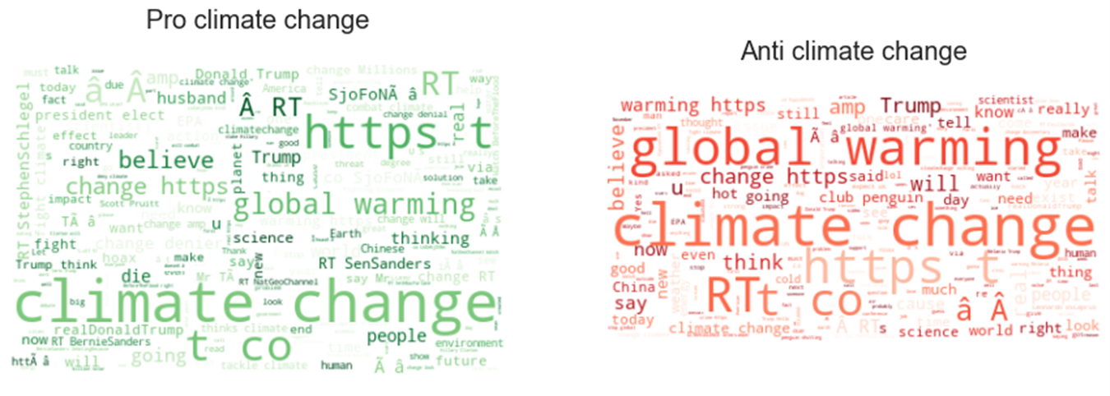
Frequently of Buzzwords
Notes:
We undertake an analysis of the buzzwords in the tweets data by extracting the most frequently used words and hashtags. This will be essential in illustrating the sentiments attached to climate change.

Slide 16
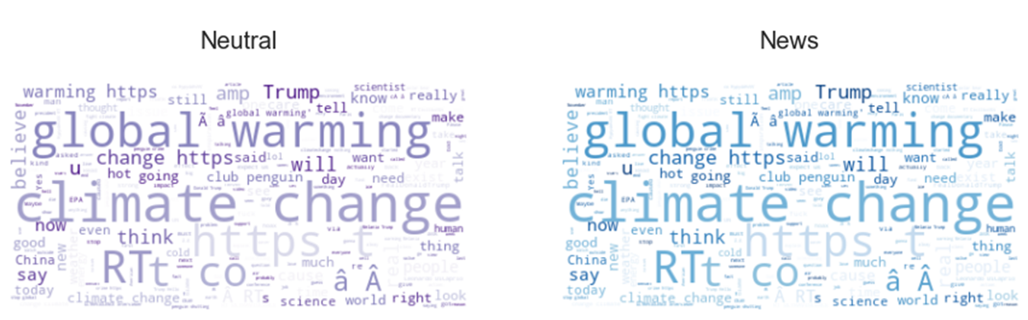
Frequently of Buzzwords
Notes:
We undertake an analysis of the buzzwords in the tweets data by extracting the most frequently used words and hashtags. This will be essential in illustrating the sentiments attached to climate change.

Slide 17
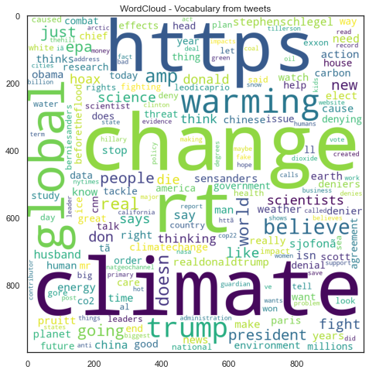
Frequently of Most Occurring Words
Notes:
create a frequency of most occurring words

Slide 18
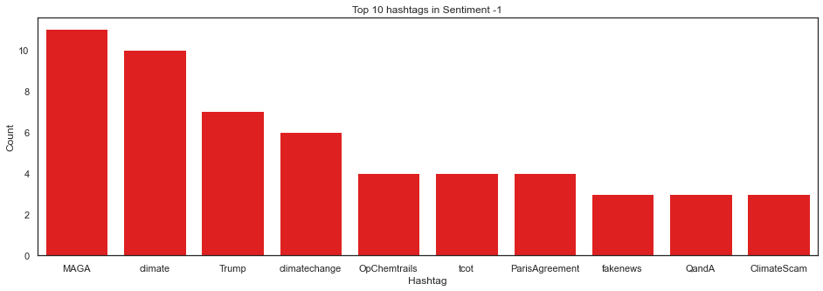
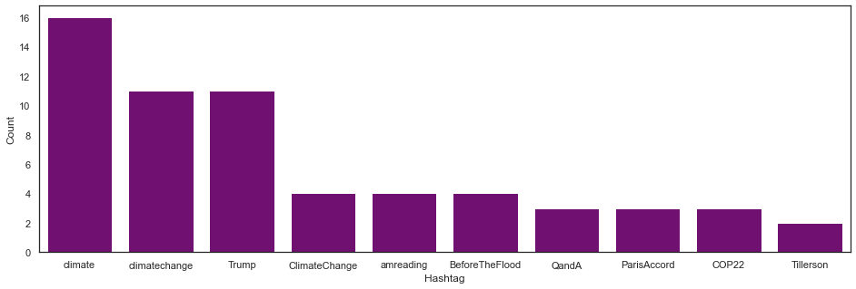
Common Hashtags in Anti Climate Change Class
Common Hashtags in Neutral Class

Slide 19
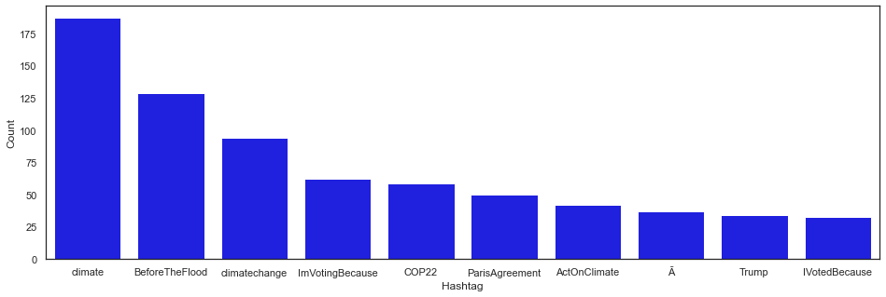
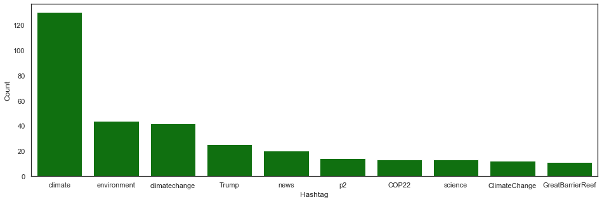
Common Hashtags in Pro Climate Change Class
Common Hashtags in News Class

Slide 20
Grin Classifier
Data Engineering
The data used in the development of this solution was well engineered using best in class approach

Slide 21
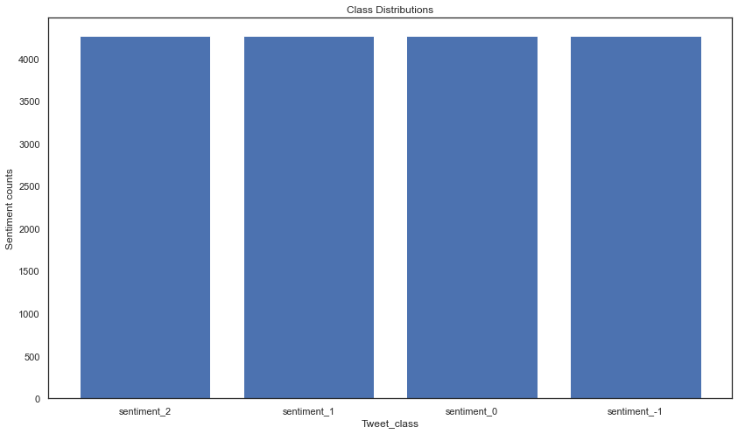
Resampled Train Data
Notes:
The train data was Resampled to take care of the class imbalance

Slide 22
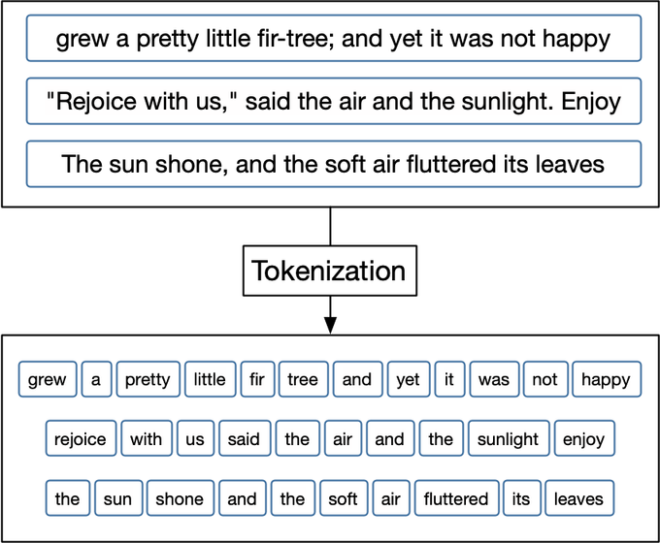
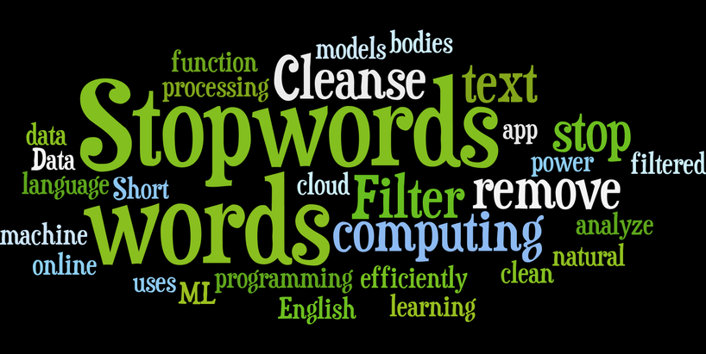
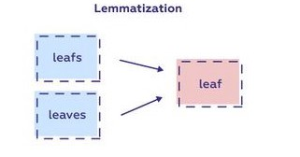
Grin Classifier
Removing Stop Words
Tokenisation
Lemmatisation

Slide 23
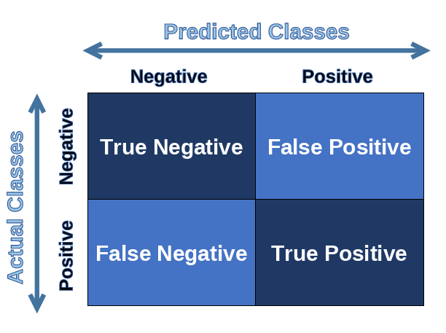
Grin Classifier
Models
Data Modelling

Slide 24
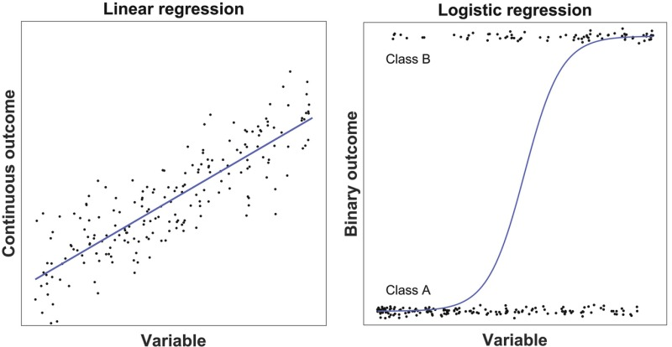
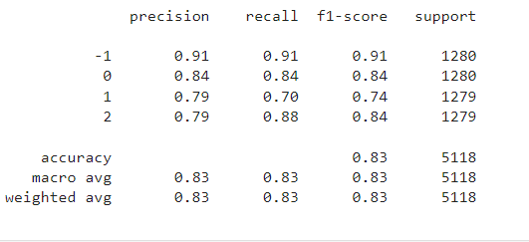
Logistics Regression

Slide 25
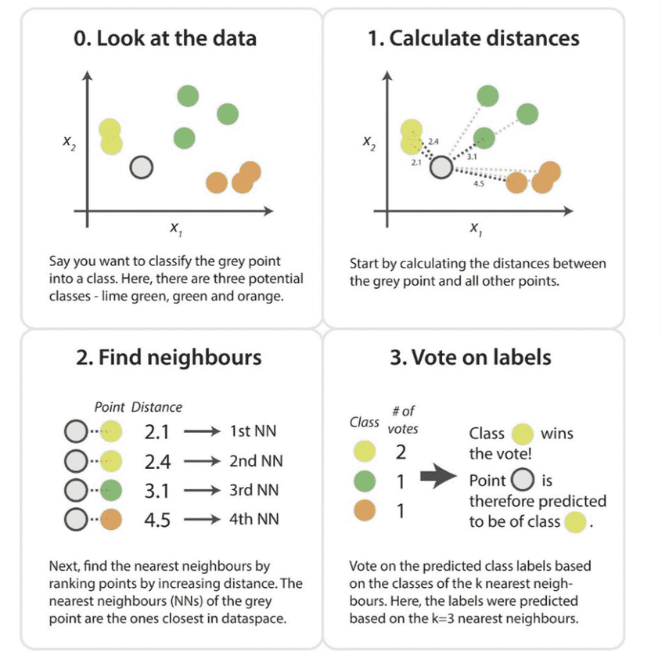
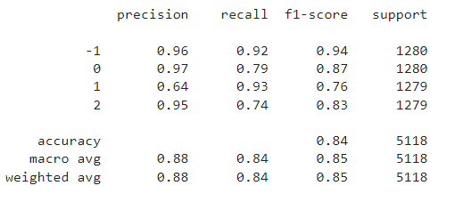
K Nearest Neighbors Classifier

Slide 26

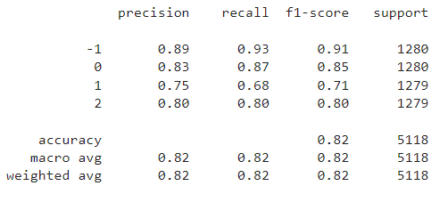
Decision Tree Classifier

Slide 27
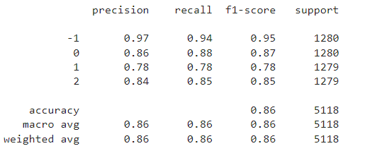

Random Forest Classifier

Slide 28

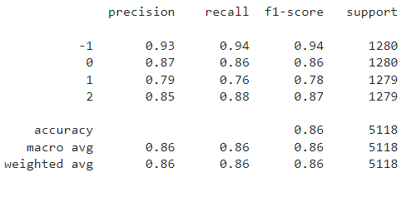
Support Vector Machine Classifier

Slide 29
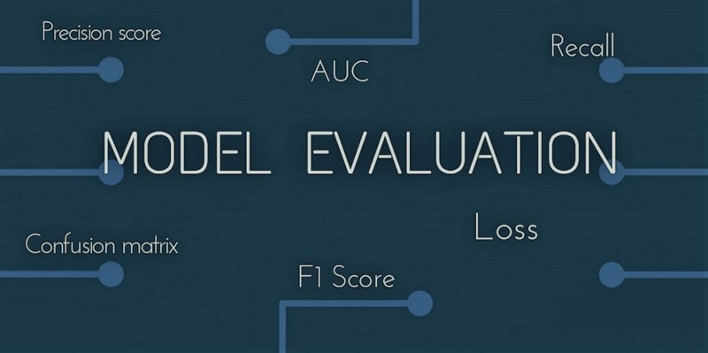
Grin Classifier
Models Performance

Slide 30
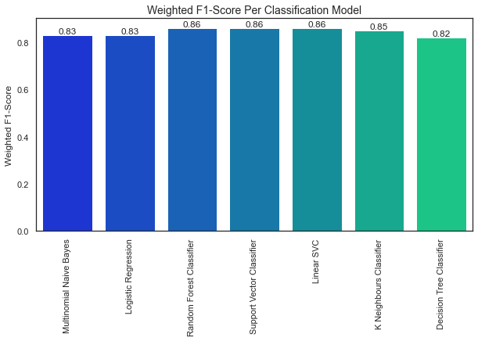
Model Performance

Slide 31

Grin Classifier
Practical Demonstration

Slide 32
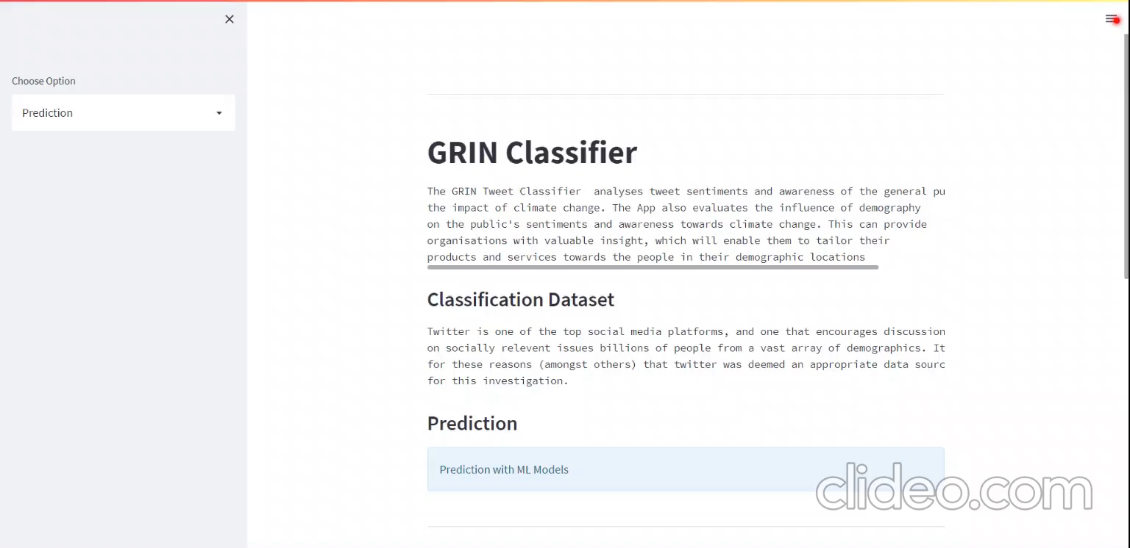

Slide 33



Organizational Benefits
50
Positive impact on Sales Campaign
40
Cost Effectiveness
30
Spike in Projected Sales
20
10
0
2017
2018
2019
2020
2021

Slide 34
THANK YOU

